Slide 1



An integrated platform for planning energy efficient cities
Leandro Madrazo
Director Research Group
ARC Engineering and Architecture La Salle
Ramon Llull University, Barcelona, Spain
KEYWORDS: urban energy systems, semantic technologies, energy efficiency, urban planning
November 18, 2014
www.semanco-project.eu

Slide 2
CONSORTIUM
SEMANCO Semantic Tools for Carbon Reduction in Urban Planning
ICT Systems for Energy Efficiency - 7th Framework Programme 2011-2014
ARC Enginyeria i Arquitectura La Salle, Universitat Ramon Llull, (Project Coordinator), SPAIN
University of Teesside and Centre for Construction Innovation & Research, UNITED KINGDOM
CIMNE, International Center for Numerical Methods in Engineering, SPAIN
Politecnico di Torino, ITALY
Faculty of Business and Computer Science, Hochschule Albstadt-Sigmaringen, GERMANY
Agency9 AB, SWEDEN
Ramboll, DENMARK
NEA National Energy Action, UNITED KINGDOM
FORUM, SPAIN
Smart City Expo World Congress, Barcelona, 18-20 November 2014

Slide 3
pROJECT
SEMANCO Semantic Tools for Carbon Reduction in Urban Planning
ICT Systems for Energy Efficiency - 7th Framework Programme 2011-2014
SEMANCO’s purpose is to provide tools that different stakeholders involved in urban planning (architects, engineers, building managers, local administrators, citizens and policy makers) need to make informed decisions about how to reduce carbon emissions in cities.
Three cities have participated as case studies:
- Manresa (Spain)
- Newcastle (United Kingdom)
- Copenhagen (Denmark)
Smart City Expo World Congress, Barcelona, 18-20 November 2014

Slide 4
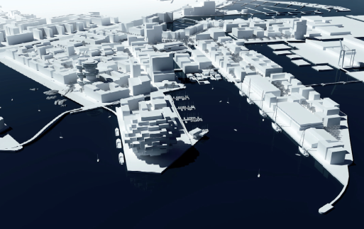
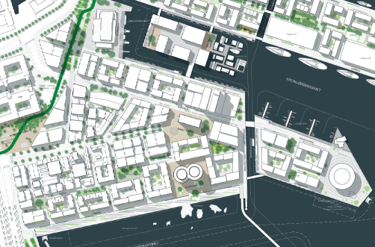
OBJECTIVES
CO₂ emissions reduction!
WP8
Enabling scenarios for stakeholders
WP6
Application domains
Regulations
Planning strategies
Urban Developments
Building Operations
Stakeholders
Policy Makers
Planners
Designers/Engineers
Building Managers
Citizens
Building stock energy modelling tool
Advanced energy information analysis tools
Energy simulation and trade-off tool
Interactive design tool
WP5
Technological
WP4
SEMANTIC ENERGY INFORMATION FRAMEWORK (SEIF)
Platform
Building repositories
Energy data
Environmental
data
Economic
data
WP3
WP2
Smart City Expo World Congress, Barcelona, 18-20 November 2014
Notes:
In computer systems, a framework is often a layered structure indicating what kind of programs can or should be built and how they would interrelate. Some computer system frameworks also include actual programs, specify programming interfaces, or offer programming tools for using the frameworks. A framework may be for a set of functions within a system and how they interrelate; the layers of an operating system; the layers of an application subsystem; how communication should be standardized at some level of a network; and so forth. A framework is generally more comprehensive than a protocol and more prescriptive than a structure .

Slide 5
URBAN ENERGY SYSTEMS AND MODELS
Cities are complex systems made up of physical elements –buildings and streets, energy supply and communication infrastructures – in which multiple actors –citizens, professionals– interact to carry out activities which put into relation the multiple dimensions of the system –economic development with transportation networks, energy consumption with buildings energy performance.
The problem of carbon emission reduction in urban areas cannot be constrained to a particular geographical area or scale, nor is it the concern of a particular discipline or expert: it is a systemic problem which involves multiple scales and domains and the collaboration of experts from various fields.
Urban energy systems are “the combined process of acquiring and using energy to satisfy the demands of a given urban area” (Keirstead and Shah, 2013).
Smart City Expo World Congress, Barcelona, 18-20 November 2014

Slide 6
URBAN ENERGY SYSTEMS AND MODELS
Models are created to assess the performance of an urban system in a particular domain (building, transport, energy), or in a combination of them. These models are abstractions of the physical structure of the city, simplified representations of what the city actually is. Most important, models should grasp the activity of an urban system: the elements that come into play with a particular purpose, the interactions among them.
An energy system model is “a formal system that represents the combined processes of acquiring and using energy to satisfy the energy service demands of a given urban area” (Keirstead et al., 2012).
The goal of SEMANCO has been to create models of urban energy systems:
  to understand the current state of the system
  to help to take decisions to influence its future evolution
Smart City Expo World Congress, Barcelona, 18-20 November 2014

Slide 7
URBAN ENERGY SYSTEMS AND MODELS
Models of urban systems rely on data: the data which is necessary to reproduce the city’s physical structure (e.g. GIS data) ; the data generated by the activity of people, goods, and services.
Energy related information is dispersed in numerous databases and open data sources and it might have different levels of quality; it is heterogeneous since it is generated by different applications in various domains; and it is dynamic, since urban energy systems are dynamic entities in continuous transformation.
Smart City Expo World Congress, Barcelona, 18-20 November 2014
Notes:
The problem of carbon emission reduction in urban areas cannot be constrained to a particular geographical area or scale, nor is it the concern of a particular discipline or expert: it is a systemic problem which involves multiple scales and domains and the collaboration of experts from various fields.

Slide 8
URBAN ENERGY SYSTEMS AND MODELS
Semantic technologies are used:
1. To integrate data from different sources (cadastre, GIS, carbon emission, energy need) and domains (urban planning, energy efficiency, economics)
2. To facilitate the interoperability between the combined data and energy assessment and analysis tools
Semantic-based models of an urban energy system embody the combined knowledge of the experts which analyze a complex problem from multiple perspectives. Such models are not just a representation of a reality, but a representation of a complex reality as conceptualised by experts.
Smart City Expo World Congress, Barcelona, 18-20 November 2014
Notes:
The problem of carbon emission reduction in urban areas cannot be constrained to a particular geographical area or scale, nor is it the concern of a particular discipline or expert: it is a systemic problem which involves multiple scales and domains and the collaboration of experts from various fields.

Slide 9
Semantic Energy Information Framework
SEMANCO Integrated Platform
Open
URBAN ENERGY MODELS
Embedded
Data
Users
Tools
LOD
Data sources
(Distributed and heterogeneous)
Tools
SEIF
Interfaced
Semantic Energy Model
(global ontology)
Private
External
Applications
ICT for Sustainable Places. Nice, 10 September 2013
Notes:
The SEIF has three main goals:
1. Integrating proprietary data which is presently off-line or/and heterogeneously structured into a consistent knowledge base, making the data accessible for information discovery and retrieval purposes.
2. Providing a bridge between different domains (city planning and energy provision) and contents (consumption data, pollution sources, simulated energy profiles and benchmarks).
3. Gathering outputs generated by the tools developed in the project –tools for design evaluation and energy simulation, visualisation and modelling at urban scale, and analysis and optimisation processes– in order to create a distributed knowledge base.

Slide 10
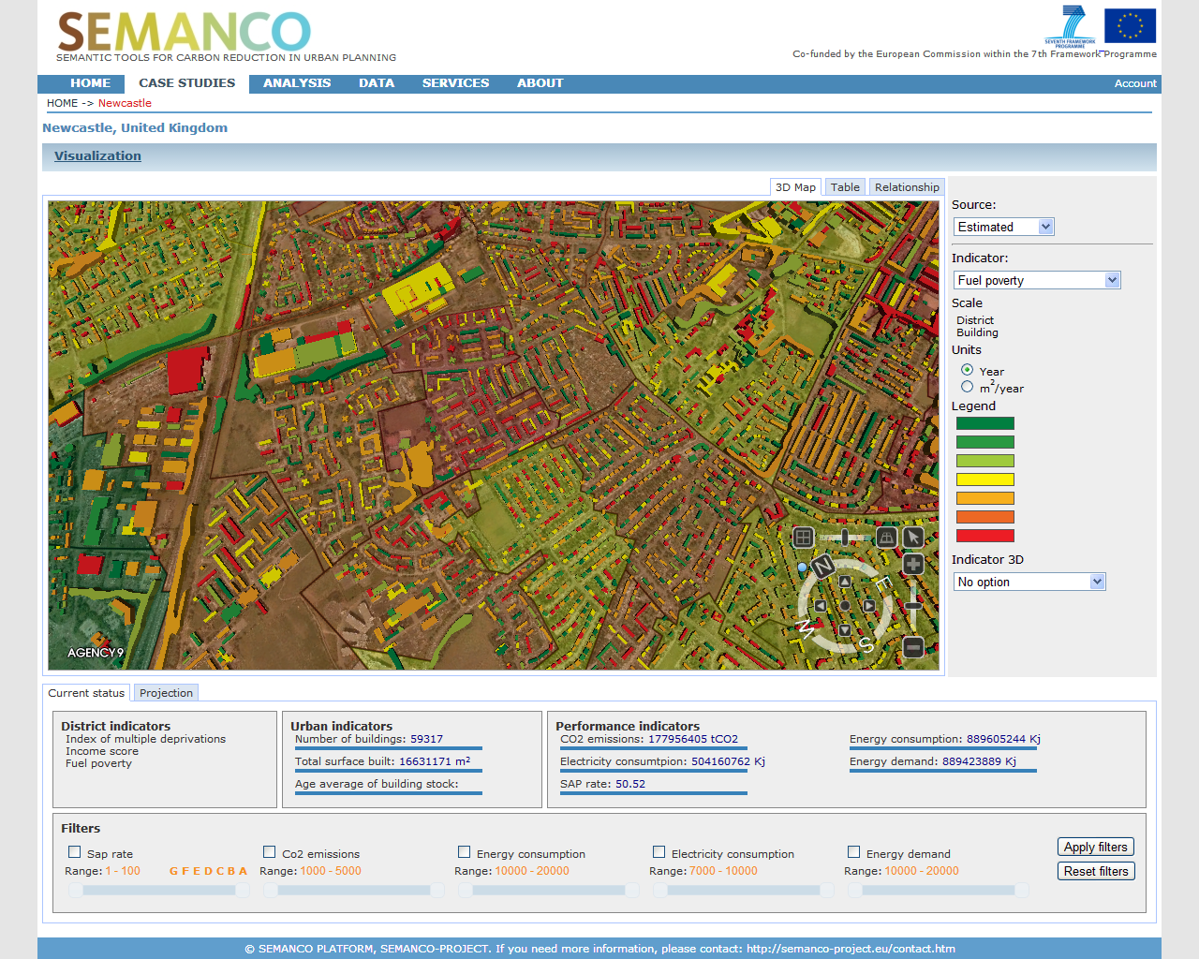
Integration of data and tools
DATA
TOOLS
Data connected through the Semantic Energy Information Framework
Energy analysis (data mining,..)
Energy simulation (URSOS, …)
Energy assessment (SAP, UEP…)
GIS model (geometric data)
Smart City Expo World Congress, Barcelona, 18-20 November 2014

Slide 11
Integration of data and tools
DATA
TOOLS
Data connected through the Semantic Energy Information Framework
Energy analysis (data mining,..)
Energy simulation (URSOS, …)
Energy assessment (SAP, UEP…)
GIS model (geometric data)
Smart City Expo World Congress, Barcelona, 18-20 November 2014

Slide 12
Integration of data and tools
DATA
TOOLS
Data connected through the Semantic Energy Information Framework
Energy analysis (data mining,..)
Energy simulation (URSOS, …)
Energy assessment (SAP, UEP…)
GIS model (geometric data)
Smart City Expo World Congress, Barcelona, 18-20 November 2014

Slide 13
Integration of data and tools
DATA
TOOLS
Data connected through the Semantic Energy Information Framework
Energy analysis (data mining,..)
Energy simulation (URSOS, …)
Energy assessment (SAP, UEP…)
GIS model (geometric data)
Smart City Expo World Congress, Barcelona, 18-20 November 2014

Slide 14
An integrated platform for planning energy efficient cities
Integration of multiple data and knowledge in a platform which enables the creation of energy models of an urban energy system
Experts’ knowledge captured in the ontologies
Experts’s knowledge describe in Use Case and Activities templates
SEMANCO INTEGRATED PLATFORM
Urban Energy System
SEIF + Semantic energy model
Urban energy model (GIS enriched with semantic data)
RDF data (semantic data)
Repositories (linked data or non-structured data) of energy related data
Smart City Expo World Congress, Barcelona, 18-20 November 2014

Slide 15
An integrated platform for planning energy efficient cities
Urban Energy Model A
Integration of multiple data and knowledge in a platform which enables the creation of energy models of an urban energy system
Data: Consumption
Tools: Simulation (Ursos)
Users: Energy consultants
Plans: Projects
Experts’ knowledge captured in the ontologies
Experts’s knowledge describe in Use Case and Activities templates
SEMANCO INTEGRATED PLATFORM
Urban Energy System
SEIF + Semantic energy model
Urban energy model (GIS enriched with semantic data)
RDF data (semantic data)
Repositories (linked data or non-structured data) of energy related data
Smart City Expo World Congress, Barcelona, 18-20 November 2014

Slide 16
An integrated platform for planning energy efficient cities
Urban Energy Model A
Integration of multiple data and knowledge in a platform which enables the creation of energy models of an urban energy system
Data: Consumption
Tools: Simulation (Ursos)
Users: Energy consultants
Plans: Projects
Experts’ knowledge captured in the ontologies
Experts’s knowledge describe in Use Case and Activities templates
SEMANCO INTEGRATED PLATFORM
Urban Energy System
SEIF + Semantic energy model
Urban Energy Model B
Urban energy model (GIS enriched with semantic data)
RDF data (semantic data)
Repositories (linked data or non-structured data) of energy related data
Data: Building properties
Tools: Assessment (SAP)
Users: Planners, City
Plans: Projects
Smart City Expo World Congress, Barcelona, 18-20 November 2014

Slide 17
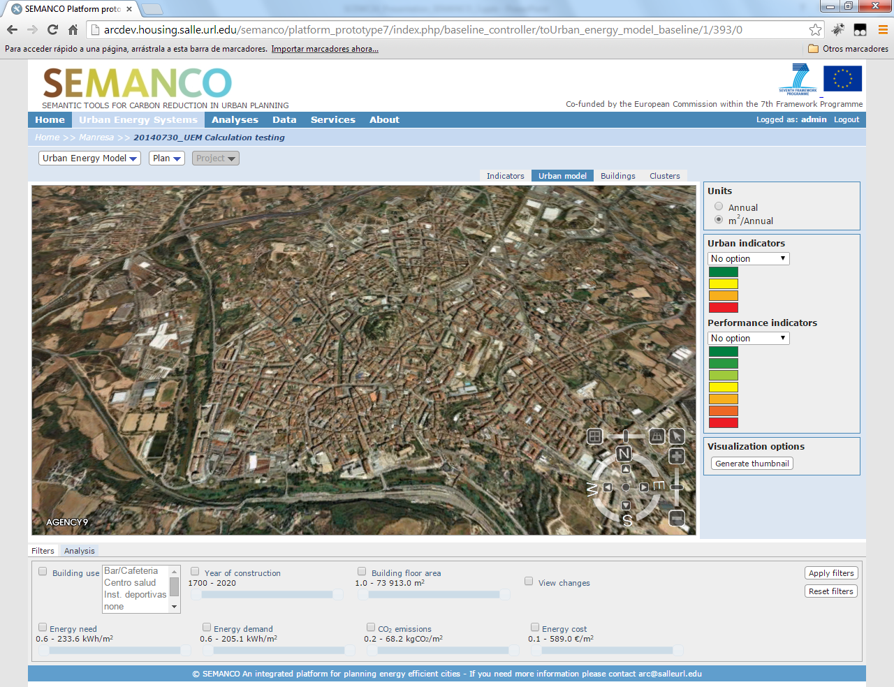
Integrated platform
VISUALIZATION MODES
URBAN ENERGY MODELS, PLANS, PROJECTS
URBAN, BUILDING PERFORMANCE INDICATORS
FILTERS
SEMANCO platform interface displaying the urban model of the Manresa city based on aerial images, terrain model and GIS data.
Smart City Expo World Congress, Barcelona, 18-20 November 2014

Slide 18
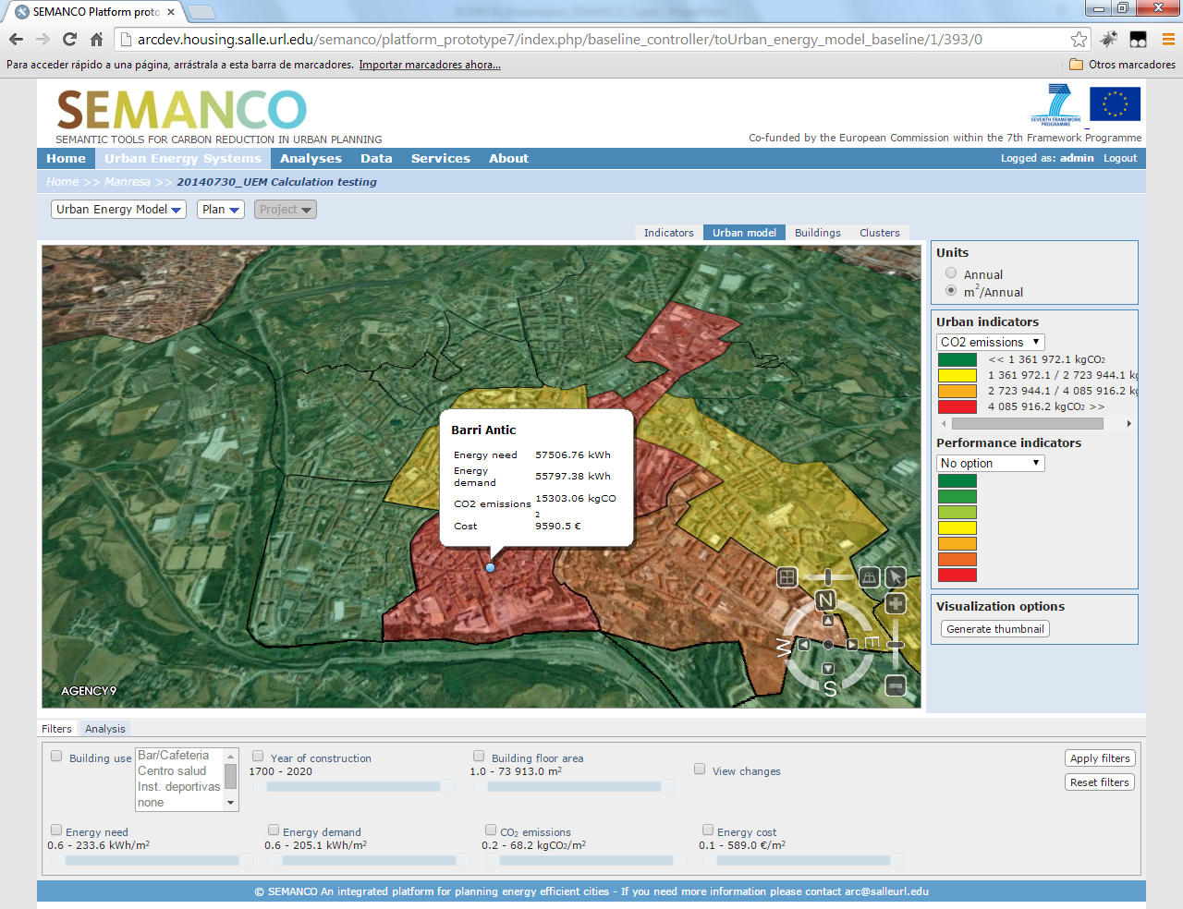
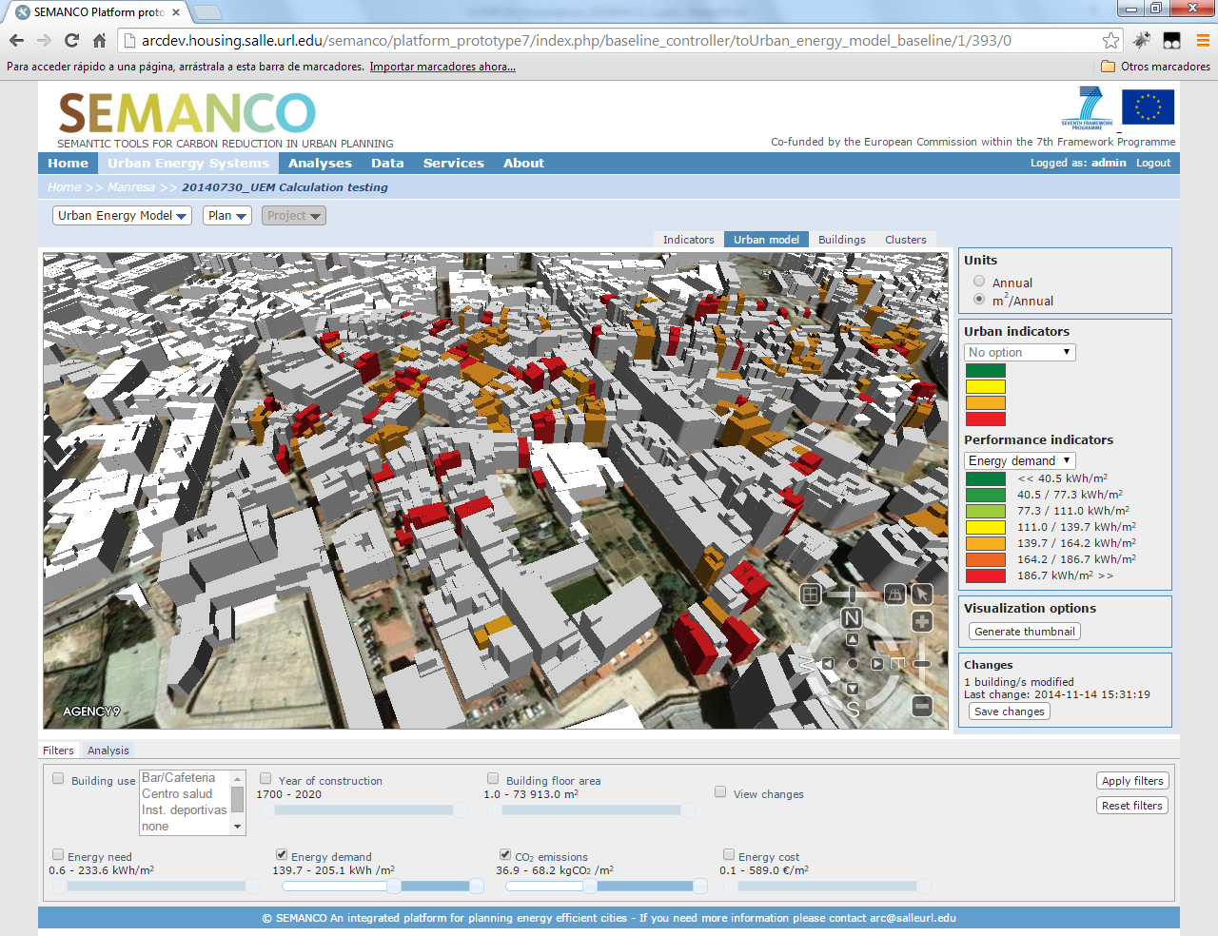
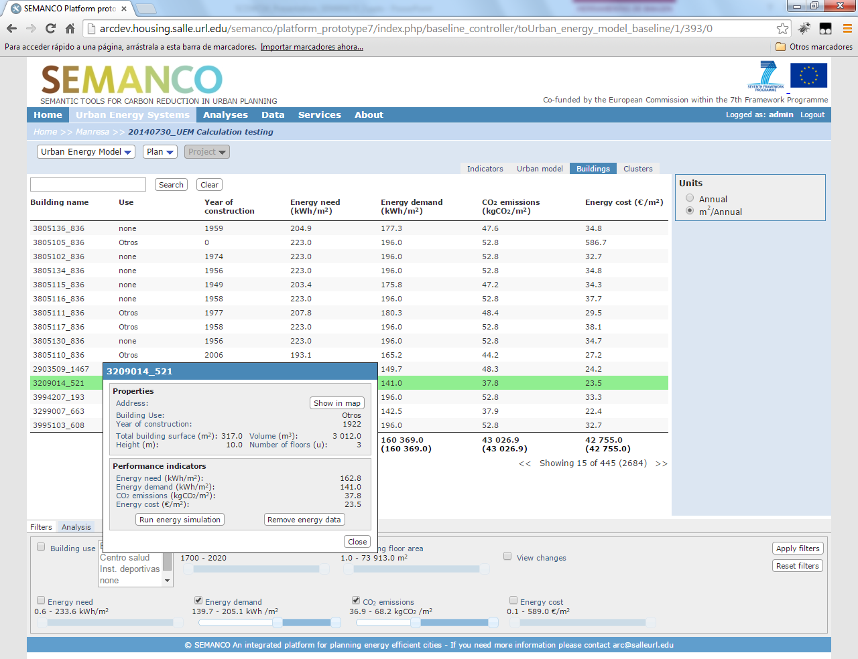
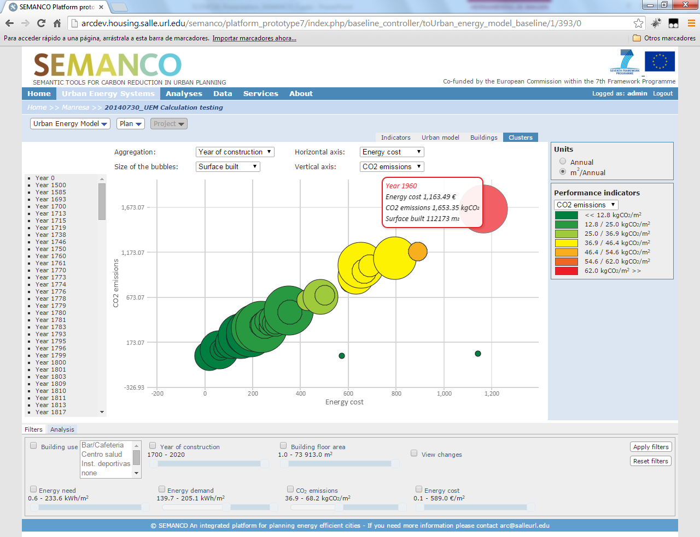
Integrated platform
Multiple scale visualization
Performance indicators filtering
Once a baseline reflecting the current state of the urban energy model has been created, different visualiztion tools can be used to identify problem areas.
Table view
Cluster view
Smart City Expo World Congress, Barcelona, 18-20 November 2014

Slide 19
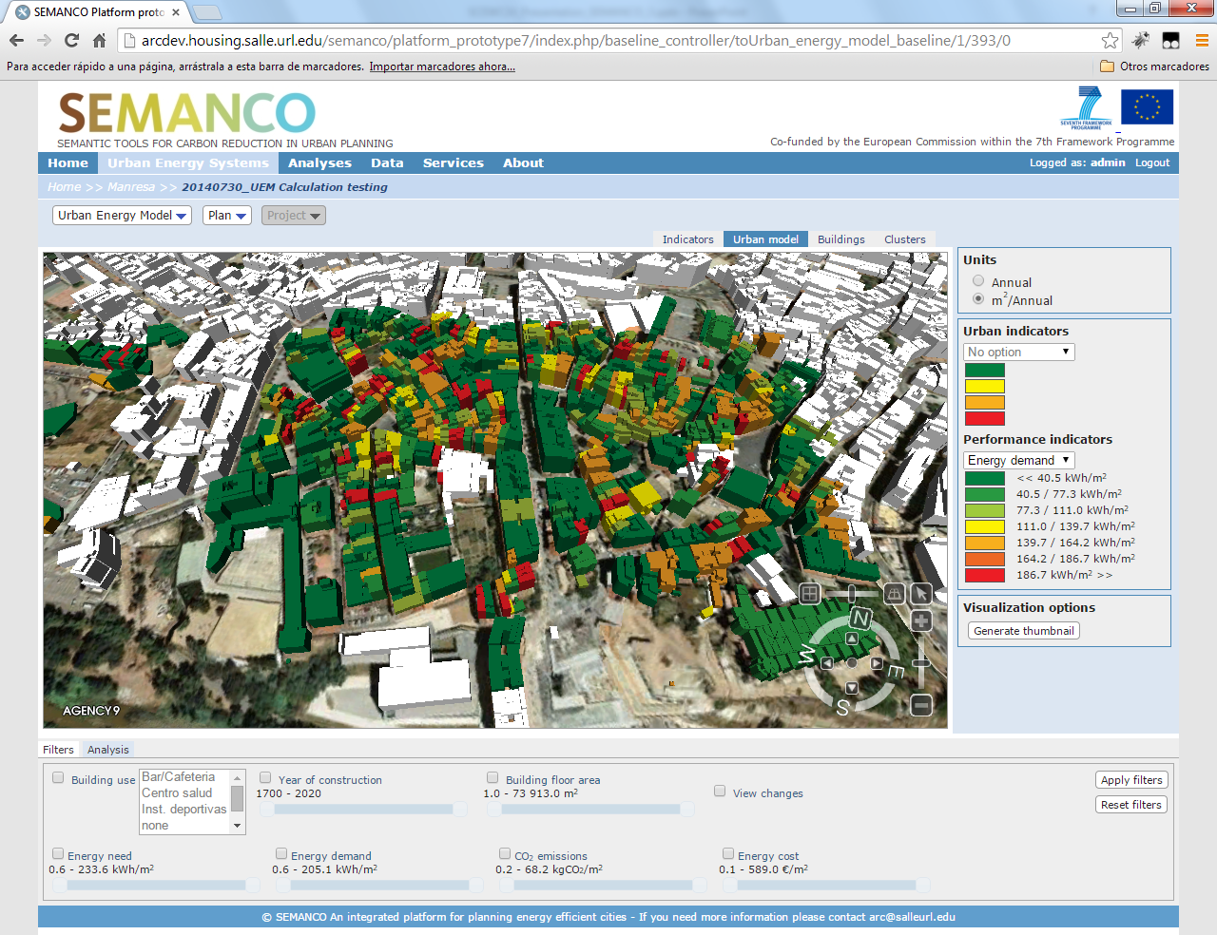
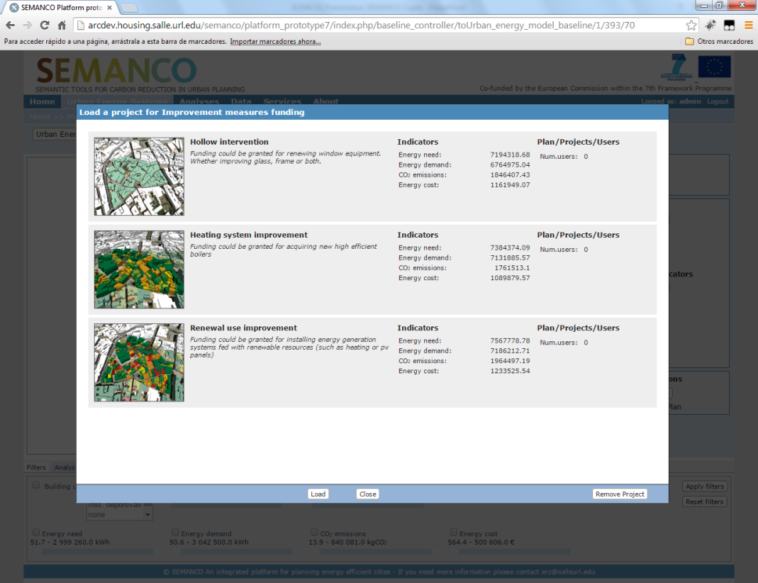
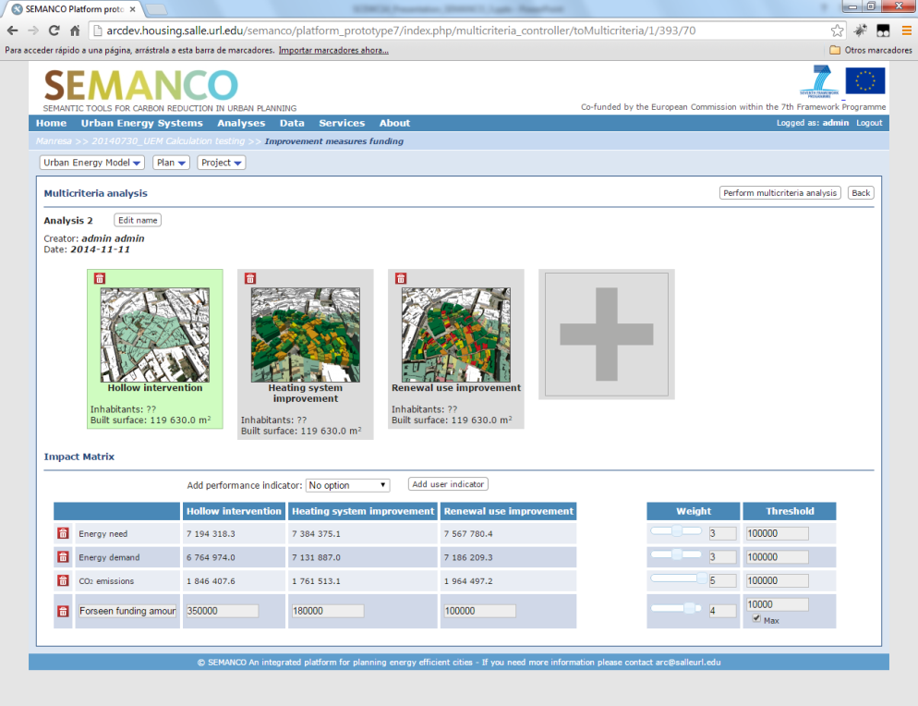
PlATFORM FUNCTIONALITIES
To determine the baseline (energy performance based on the available data and tools) of an urban area
1
2
To create plans and projects to improve the existing conditions
3
To evaluate projects
Smart City Expo World Congress, Barcelona, 18-20 November 2014

Slide 20
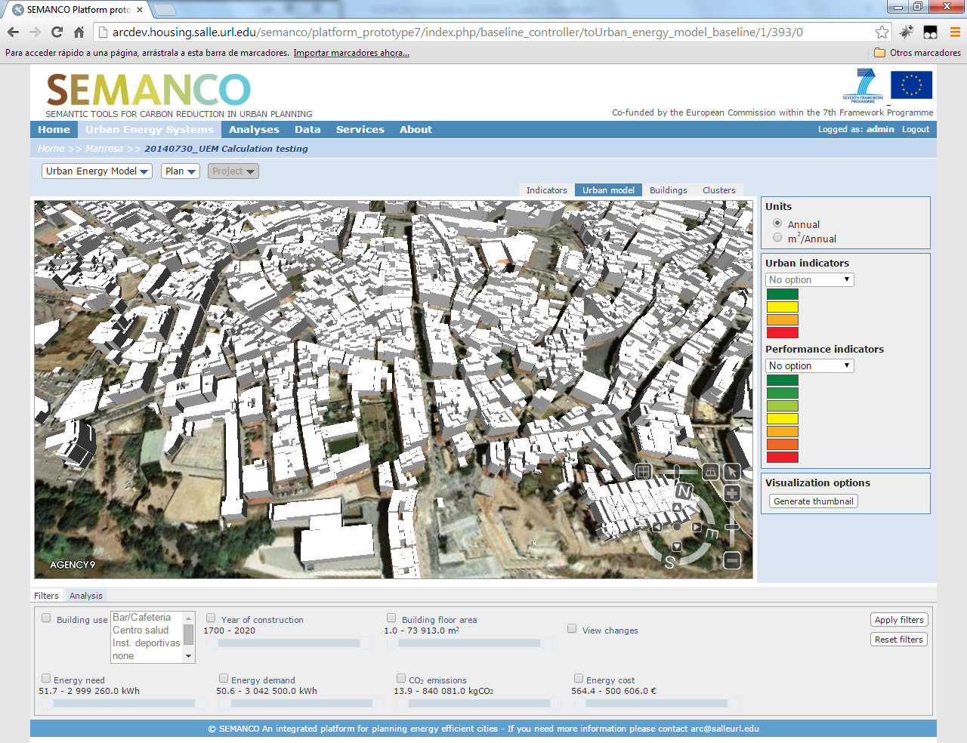
Integrated platform : URBAN ENERGY MODEL
3D model created after the GIS of the Manresa city
Smart City Expo World Congress, Barcelona, 18-20 November 2014

Slide 21
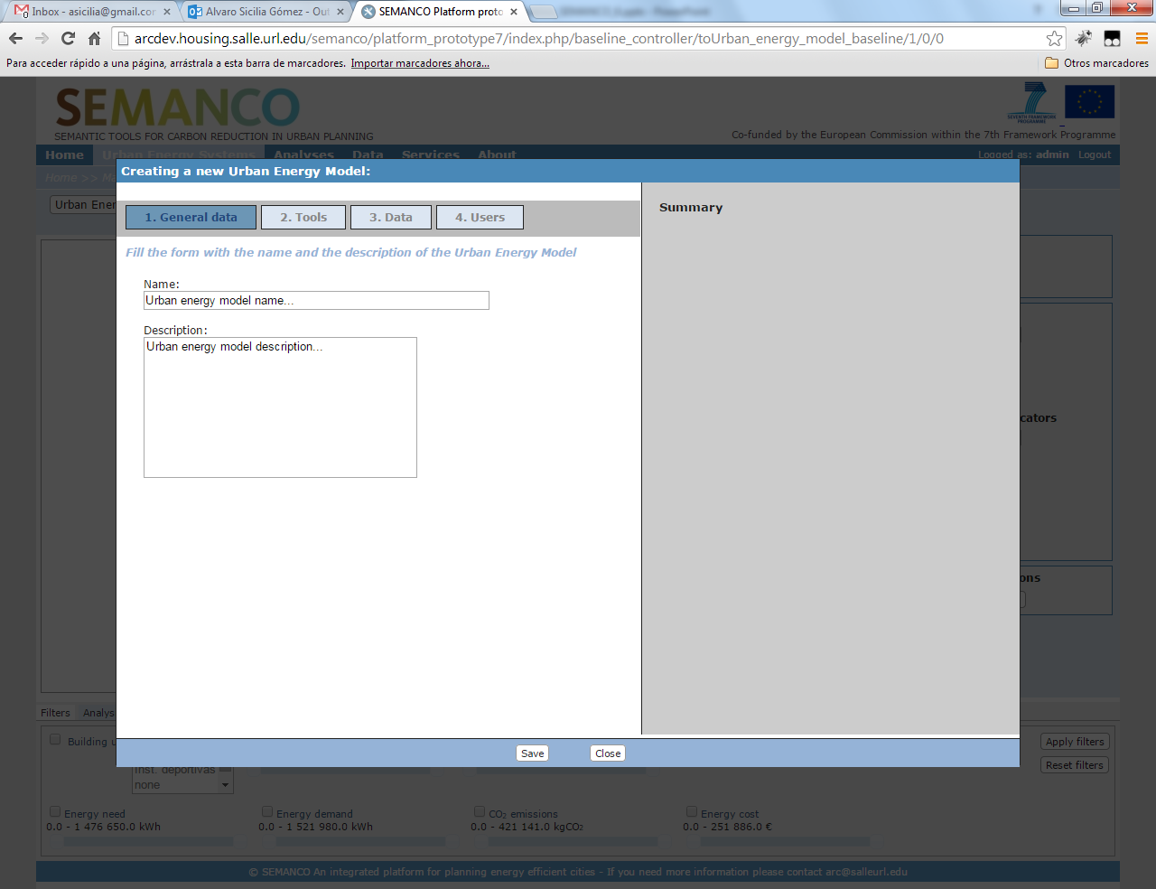
Integrated platform : URBAN ENERGY MODEL
Creation of an Urban Energy Model
Smart City Expo World Congress, Barcelona, 18-20 November 2014

Slide 22
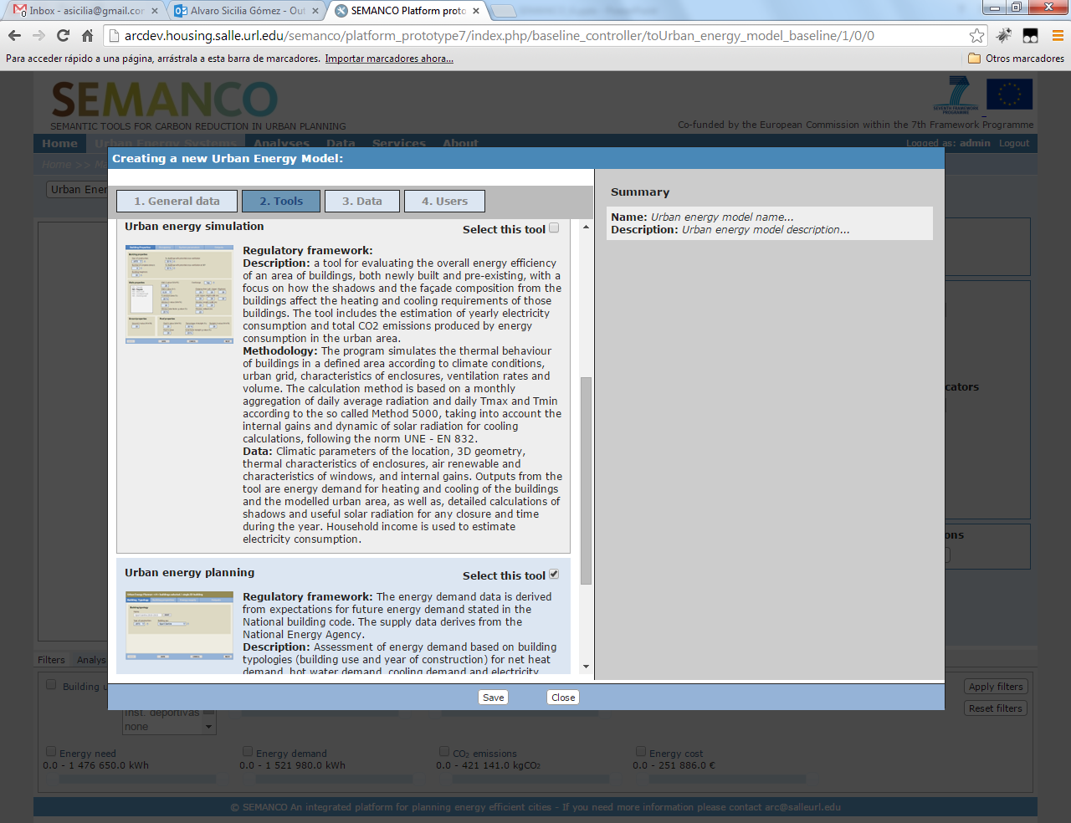
Integrated platform : URBAN ENERGY MODEL
Selection of the tools for creating the baseline in the Urban Energy Model. Each tool includes the regulatory framework, a general description, the underlying methodology and the data sources required by the tool.
Smart City Expo World Congress, Barcelona, 18-20 November 2014

Slide 23
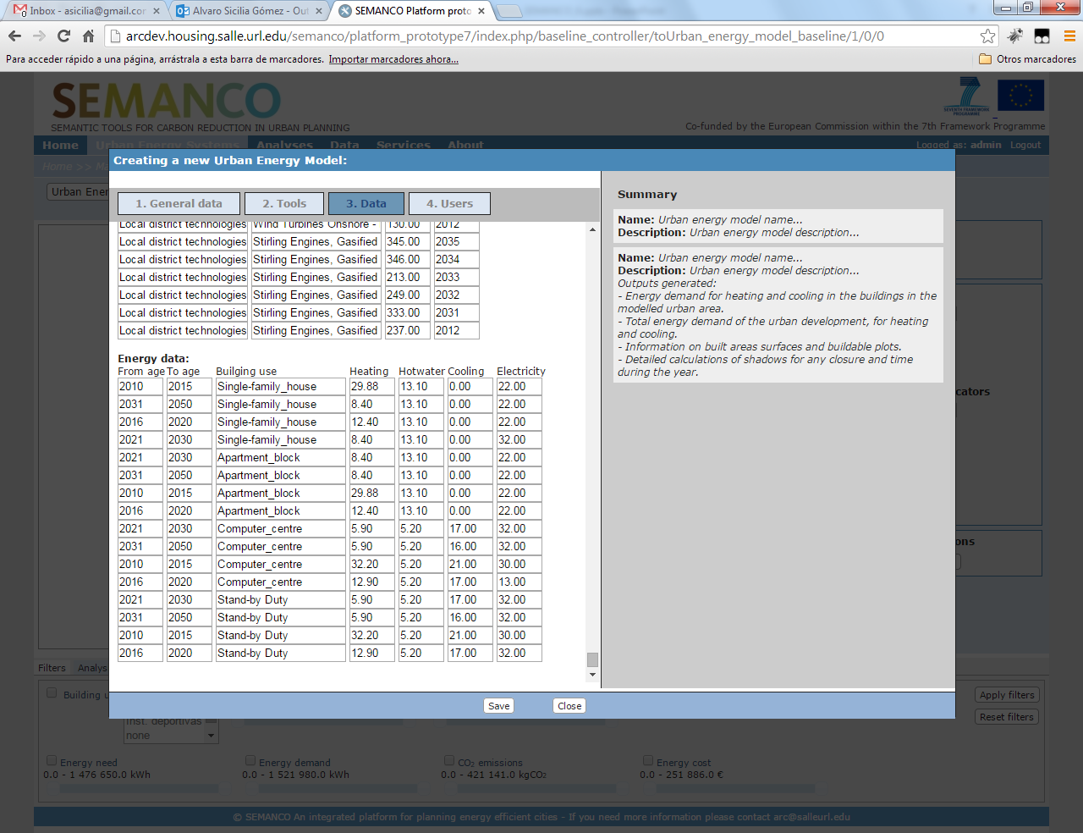
Integrated platform : URBAN ENERGY MODEL
After selecting the tool, the data sources can be customized by the user
Smart City Expo World Congress, Barcelona, 18-20 November 2014

Slide 24
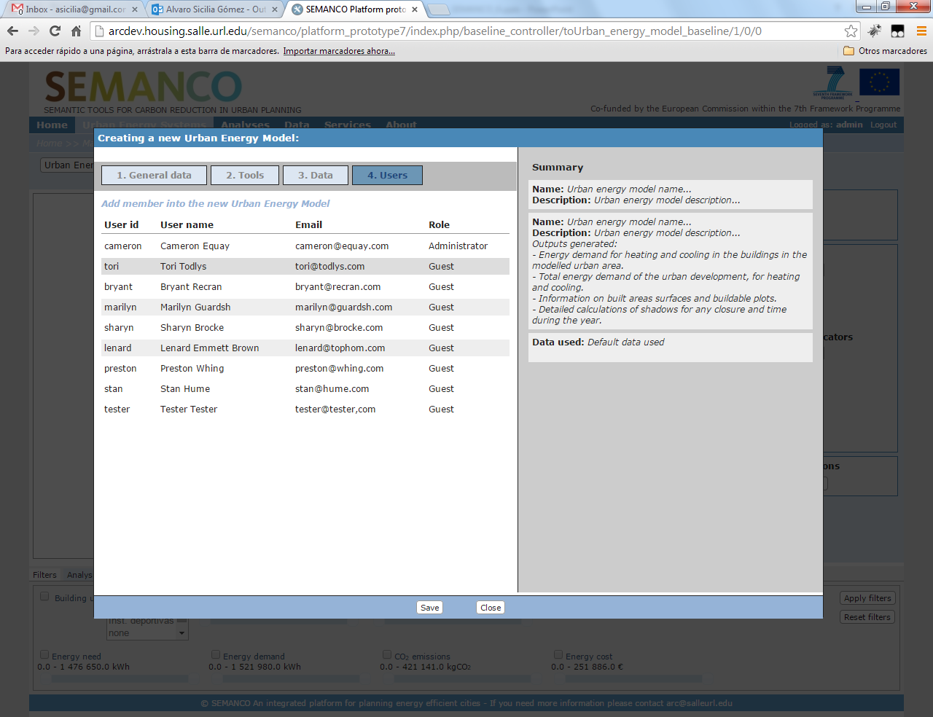
Integrated platform : URBAN ENERGY MODEL
Finally, the users who are going to participate in the Urban Energy Model are selected.
Smart City Expo World Congress, Barcelona, 18-20 November 2014

Slide 25
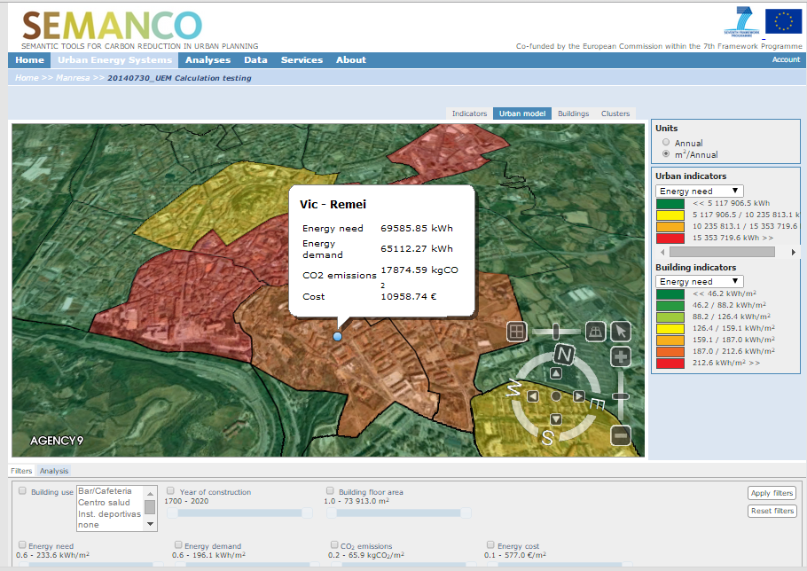
Integrated platform : URBAN ENERGY MODEL: BASELINE
Energy demand of buildings calculated with an energy assessment tool (URSOS) integrated in the platform. Visualizing the energy performance at the neighborhood level.
Smart City Expo World Congress, Barcelona, 18-20 November 2014

Slide 26
Integrated platform : URBAN ENERGY MODEL: BASELINE
Visualization at the building level.
Smart City Expo World Congress, Barcelona, 18-20 November 2014

Slide 27
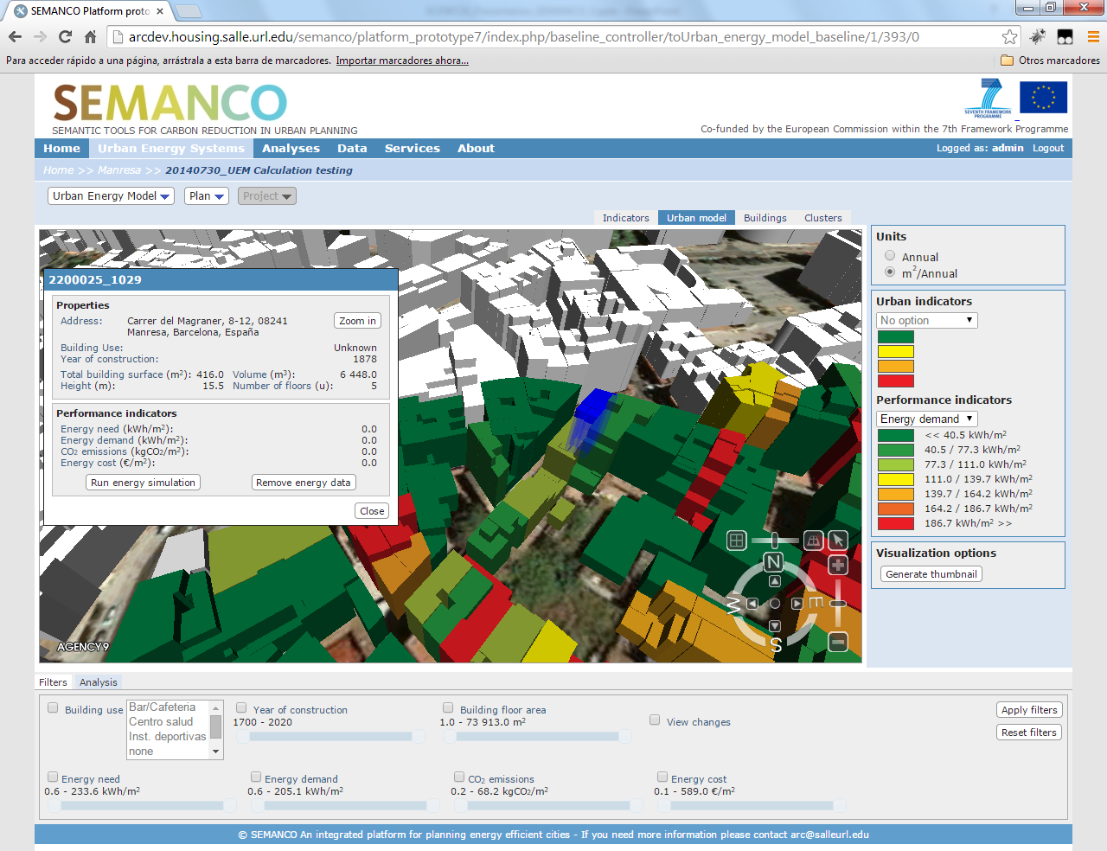
Integrated platform : URBAN ENERGY MODEL: BASELINE
Street address obtained from Google Geolocation services
Year of construction obtained from the cadastre
Building geometry obtained from the 3D model
Performance values to be calculated with energy assessment tool
information concerning the selected building which have not yet assessed
Smart City Expo World Congress, Barcelona, 18-20 November 2014

Slide 28
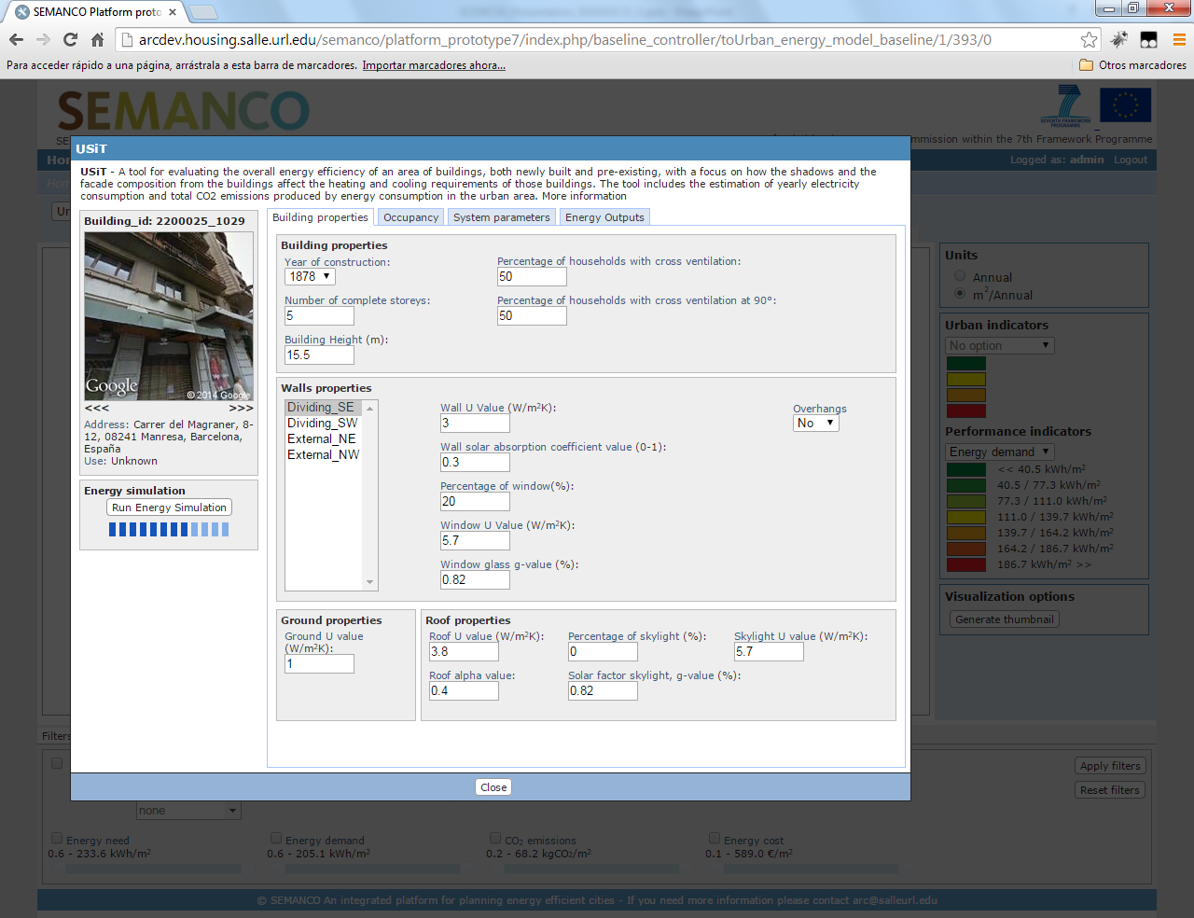
Integrated platform : URBAN ENERGY MODEL: BASELINE
Interface of the URSOS tool. The input data is automatically filled thanks to the semantic integration of different data sources. Users can modify the input data in case there are errors.
Smart City Expo World Congress, Barcelona, 18-20 November 2014

Slide 29
Integrated platform : URBAN ENERGY MODEL: BASELINE
Year of construction from the Cadastre
Ventilation from the building typologies database
Geometry obtained from the 3D model
Street address name and Street view from Google Geolocation services
Wall, ground and roof properties from the building typologies database
Interface of the URSOS tool. The input data is automatically filled thanks to the semantic integration of different data sources. Users can modify the input data in case there are errors.
Smart City Expo World Congress, Barcelona, 18-20 November 2014

Slide 30
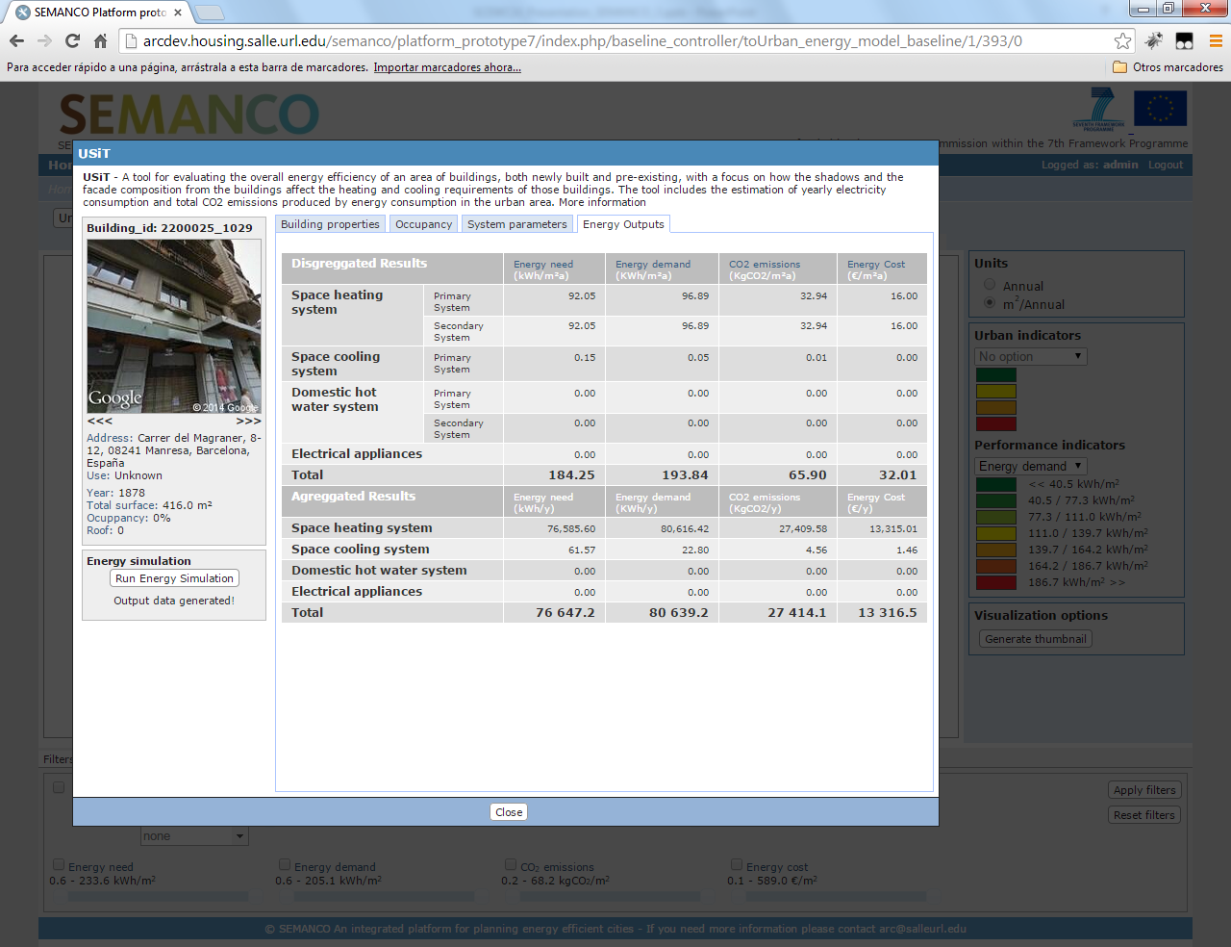
Integrated platform : URBAN ENERGY MODEL: BASELINE
Results of the energy simulation carried out by URSOS
Smart City Expo World Congress, Barcelona, 18-20 November 2014

Slide 31
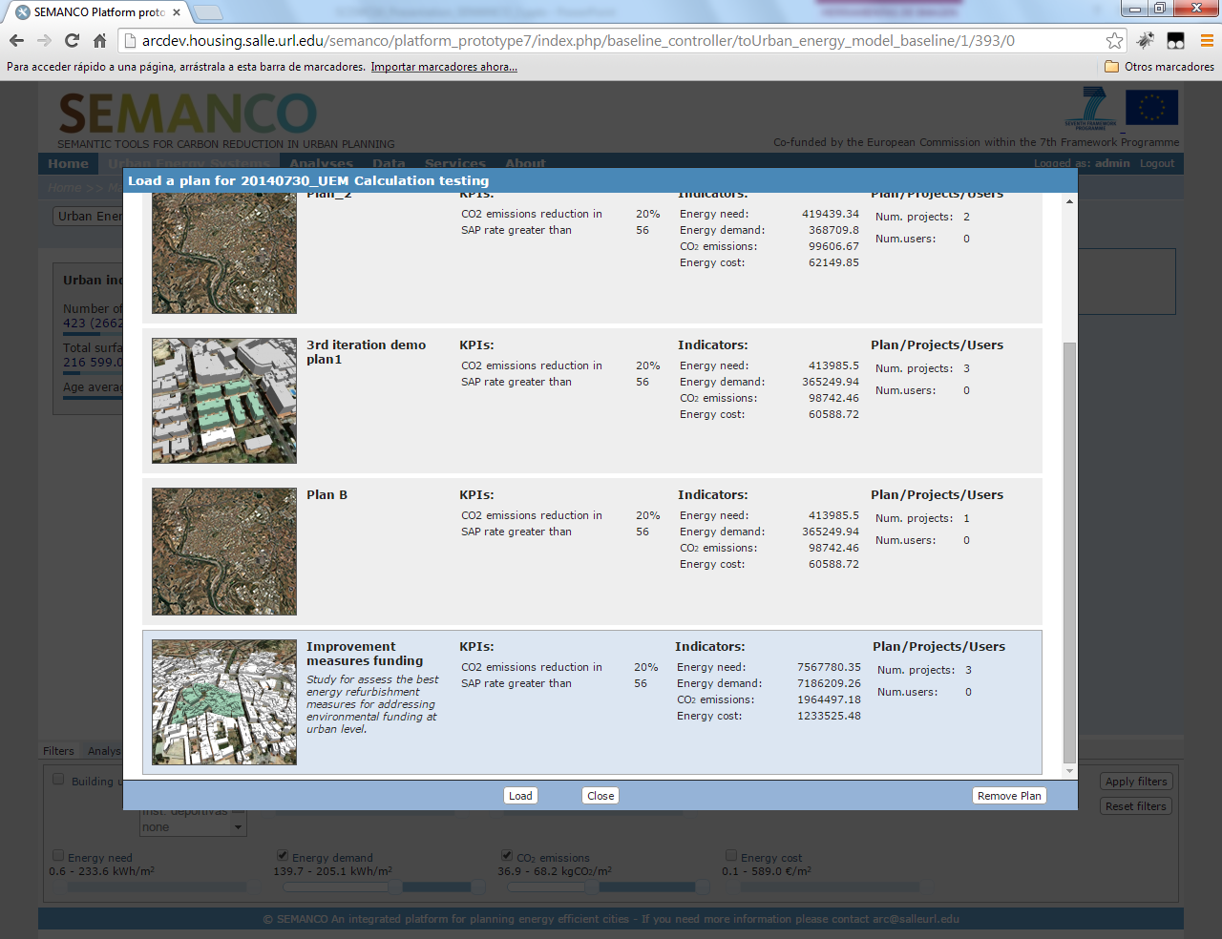
Integrated platform : UrBAN ENERGY MODEL: PLANS
Creating plans to improve energy efficiency of buildings
Smart City Expo World Congress, Barcelona, 18-20 November 2014

Slide 32
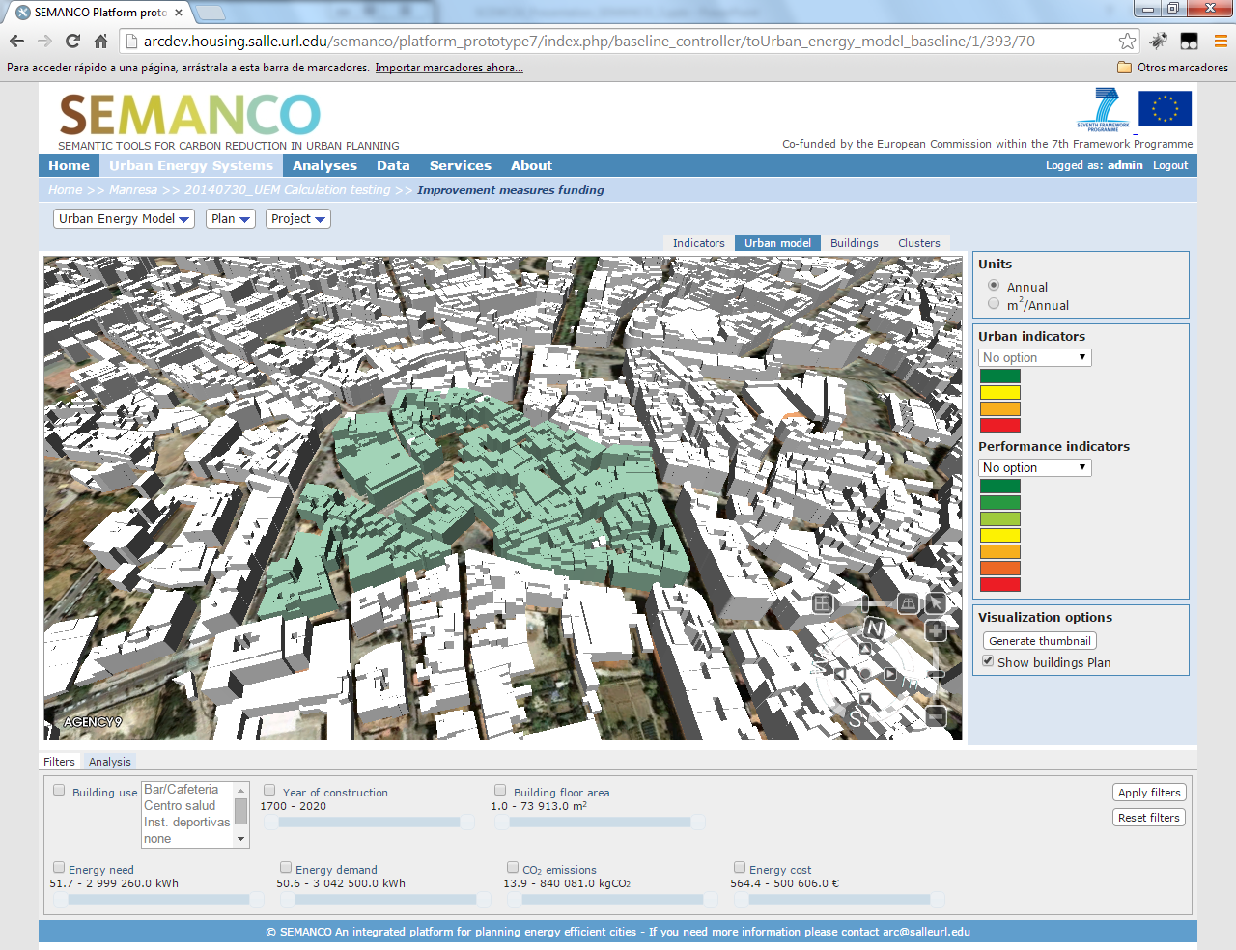
Integrated platform : UrBAN ENERGY MODEL: PLANS
Selecting buildings which belong to the plan at stake. They have been spotted before with the baseline assessment tools.
Smart City Expo World Congress, Barcelona, 18-20 November 2014

Slide 33

Integrated platform : UrBAN ENERGY MODEL: PLANS : PROJECTS
Projects to apply improvement measures
Smart City Expo World Congress, Barcelona, 18-20 November 2014

Slide 34
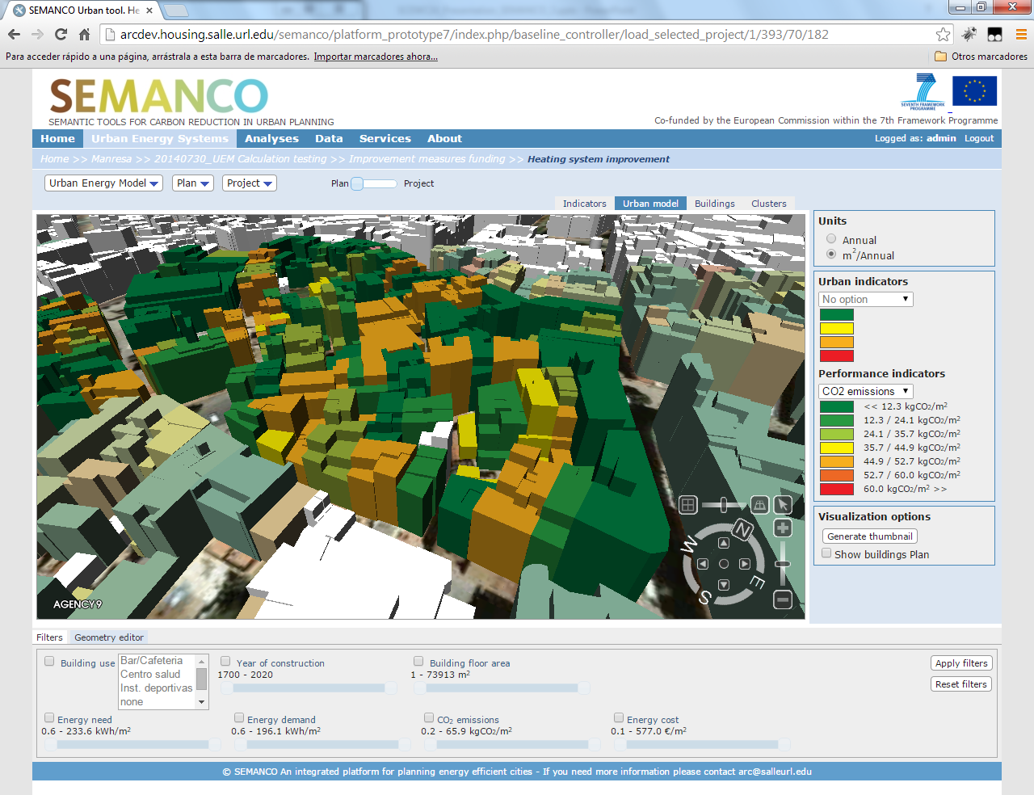
Integrated platform : UrBAN ENERGY MODEL: PLANS : PROJECTS
Current status of the buildings before applying measures
Smart City Expo World Congress, Barcelona, 18-20 November 2014

Slide 35
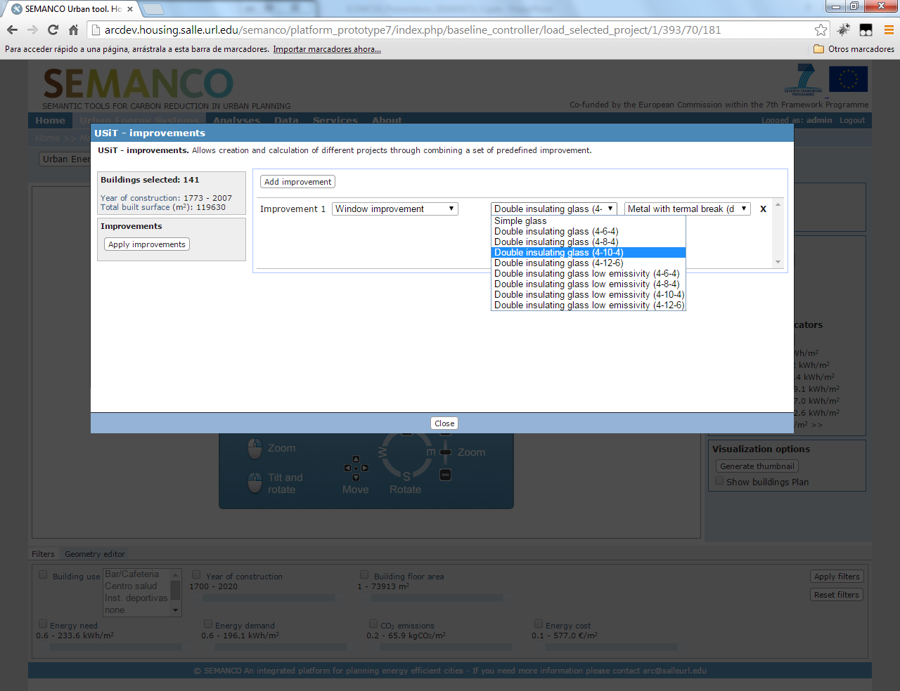
Integrated platform : UrBAN ENERGY MODEL: PLANS : PROJECTS
Applying improvements. For example, renovating the existing windows or replacing them with new ones
Smart City Expo World Congress, Barcelona, 18-20 November 2014

Slide 36
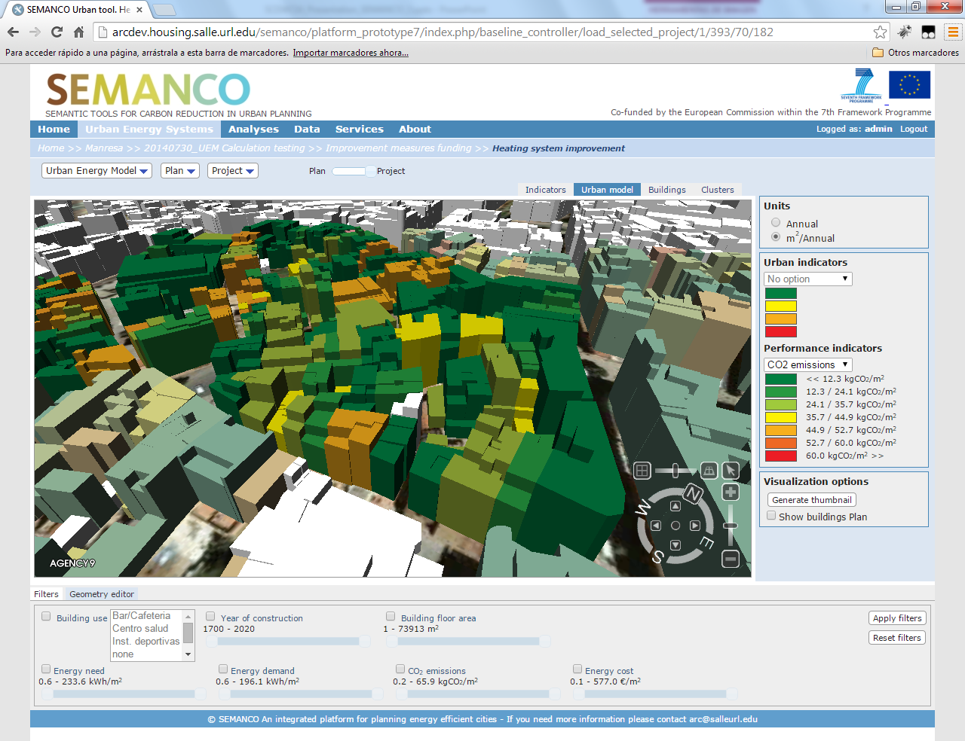
Integrated platform : UrBAN ENERGY MODEL: PLANS : PROJECTS
Results after applying the improvement measures
Smart City Expo World Congress, Barcelona, 18-20 November 2014

Slide 37

Integrated platform : URBAN ENERGY MODEL: PLANS : PROJECTS : EVALUATION
Projects can be compared with a multi-criteria decision tool included in the platform. Users can select the weight (importance) of the performance indicators. Besides, other indicators defined by users can be included in the analysis, for example: foreseen funding.
Smart City Expo World Congress, Barcelona, 18-20 November 2014

Slide 38
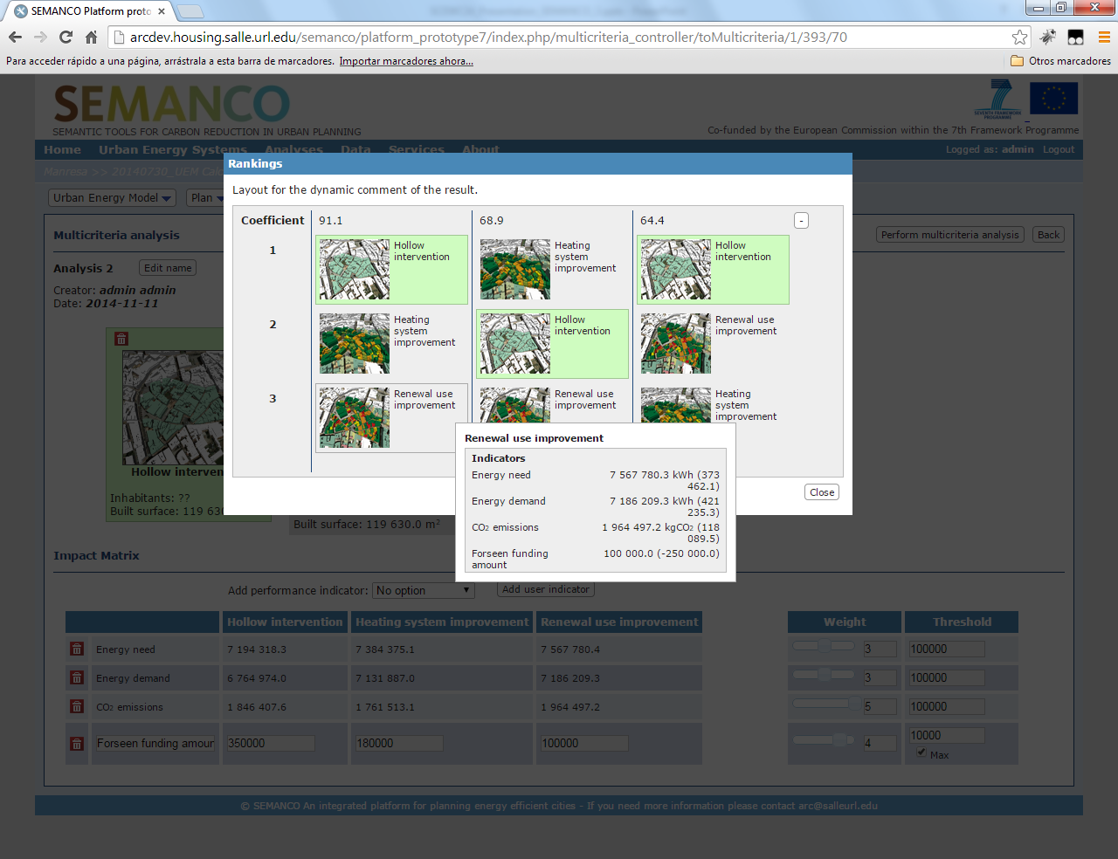
Integrated platform : URBAN ENERGY MODEL: PLANS : PROJECTS : EVALUATION
The results of the multi-criteria analysis: in green color the best choices.
Smart City Expo World Congress, Barcelona, 18-20 November 2014

Slide 39
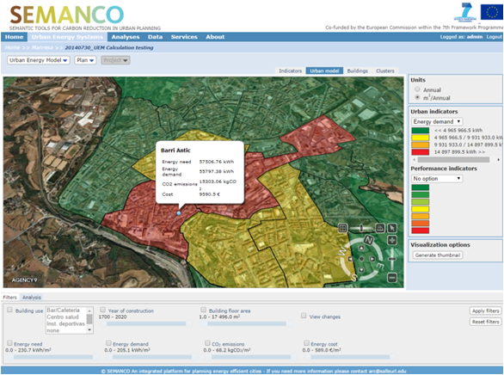
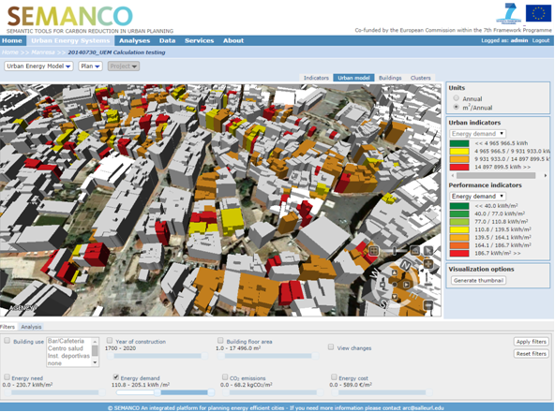
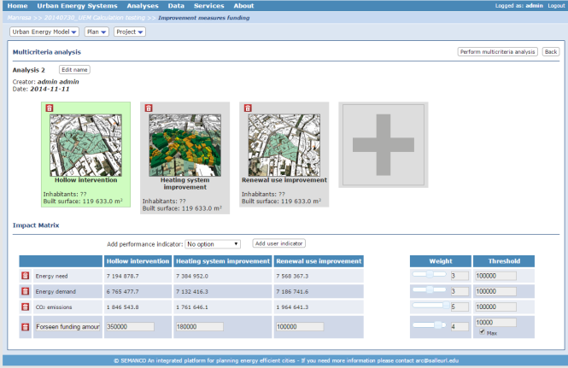
Demonstration scenario: Manresa, SPAIN
The main goal of the demonstration in the Manresa case study is to assess the effectiveness of the measures to refurbish buildings in two neighbourhoods.
The users (Architect, Industrial Engineer, Engineer, Urban Planner) evaluate the impact of the energy efficiency on the building by using the URSOS simulating software tool integrated in the platform.
Data sources: Cadastre, census, socio-economic, building typologies(u-values, windows properties, systems…)
Three different projects were assessed:
Building envelope: upgrading windows
Heating system improvement: acquiring new high efficient boilers
Use of renewable energies: installing energy generation systems fed with renewable sources.
Smart City Expo World Congress, Barcelona, 18-20 November 2014

Slide 40
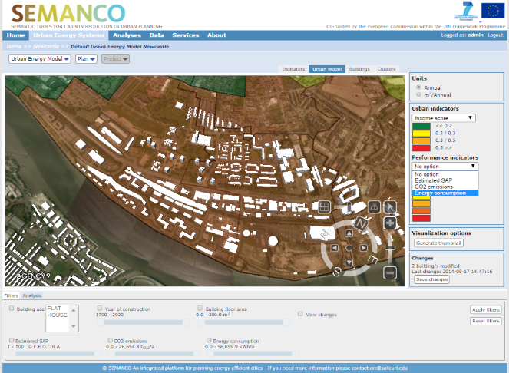
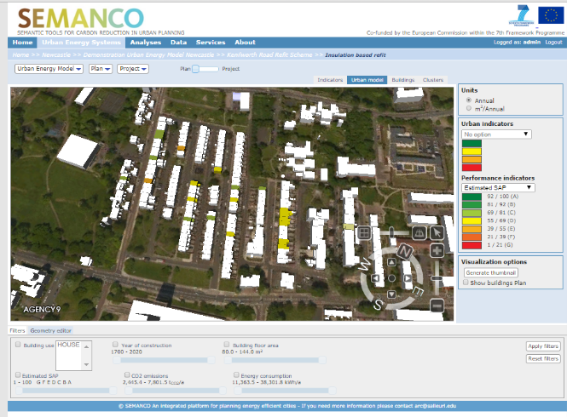
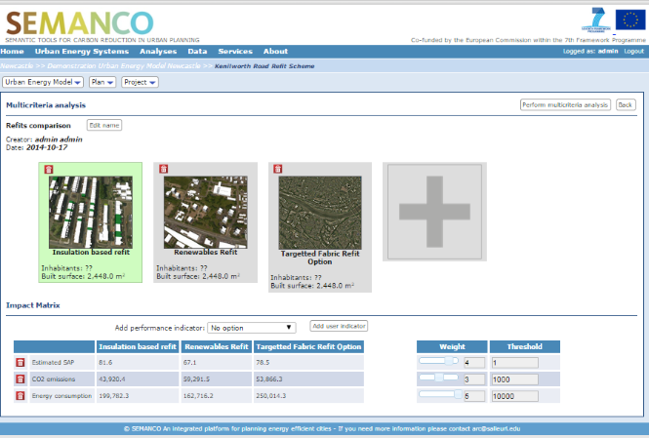
Demonstration scenario: Newcastle, UK
The main goal of the demonstration in the Newcastle case study is to identify housing buildings with a high risk of fuel poverty and to propose measure to upgrade them.
An Energy Consultant has been contracted by Newcastle City Council to come up with scenarios to improve low energy efficient dwellings in the Kenilworth Road area which is currently amongst the worst performing streets in Newcastle upon Tyne.
Data sources: Lower Level Super Output Area (LLSOA): income, fuel poverty, Index of multiple deprivation.
Three different projects were assessed:
Insulation based refit
Renewables refit
Targeted fabric refit
Notes:
This demonstration scenario considers a user as being an urban planner from the Environmental Department of the Municipality. This user has been assigned the task of evaluating several potential new strategies currently being debated between representatives at the city hall. The user has been asked to evaluate them in order to quantify and inform the discussions among the politicians. The politicians are eager to find out how different supply strategies will affect their ambitions within climate policies and whether they should go for local supply or a central solution if they want to act in accordance with their previously established climate goals. Currently they are debating about the possibility to change their energy supply plan into one with heat pumps for one of the larger buildings in the new area. lower layer super output areas (LSOA

Slide 41
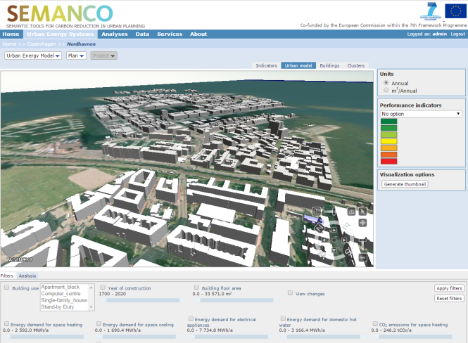
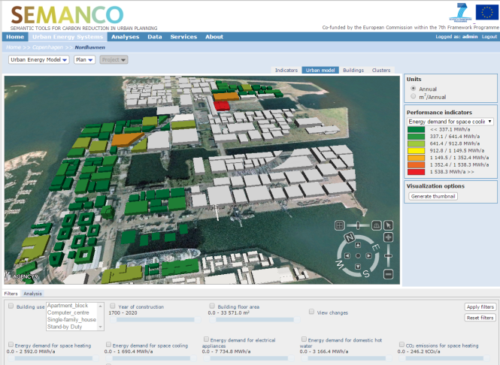
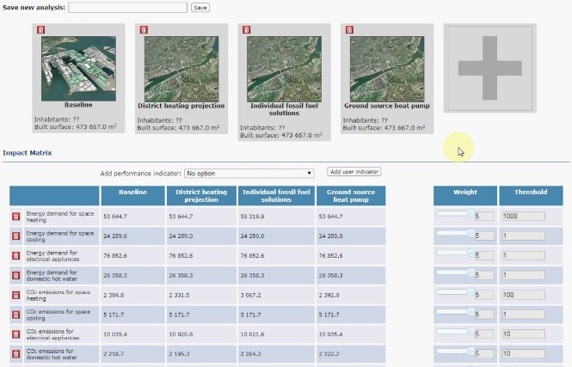
Demonstration scenario: Copenhagen, DENMARK
The main goal of the demonstration in the Copenhagen case study is to assess different strategies regarding supply of energy, based both on central and distributed solutions in a greenfield planning situation.
An urban planner from the Environmental Department of the Municipality has been assigned the task to evaluate new strategies currently being debated by local authorities. One of them is to change energy supplied by heat pumps.
Data sources: building typologies (supply technologies, energy demand), carbon emission coefficients.
Three different projects were assessed:
District heating projection
Individual fossil fuel solutions
Ground source heat pump
Notes:
This demonstration scenario considers a user as being an urban planner from the Environmental Department of the Municipality. This user has been assigned the task of evaluating several potential new strategies currently being debated between representatives at the city hall. The user has been asked to evaluate them in order to quantify and inform the discussions among the politicians. The politicians are eager to find out how different supply strategies will affect their ambitions within climate policies and whether they should go for local supply or a central solution if they want to act in accordance with their previously established climate goals. Currently they are debating about the possibility to change their energy supply plan into one with heat pumps for one of the larger buildings in the new area.

Slide 42
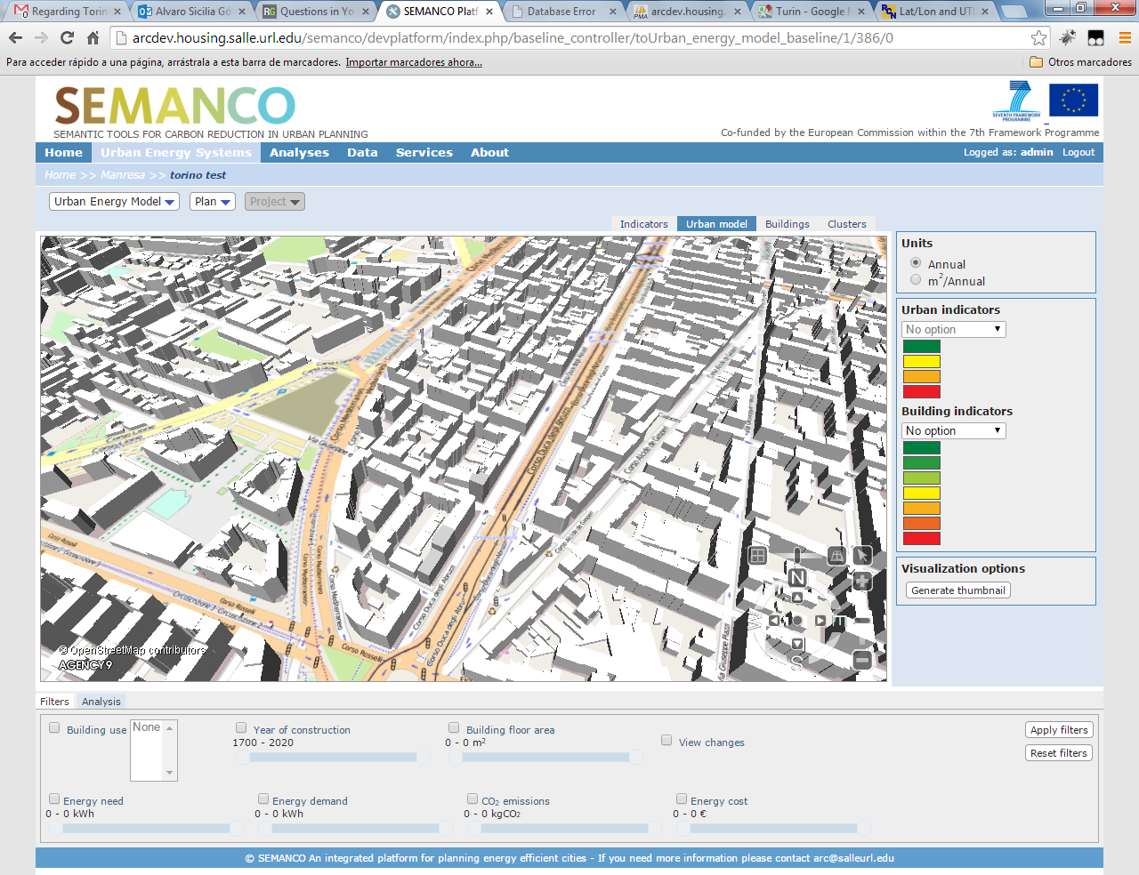
CASE STUDY: TORINO
Notes:
no tiene nombre creo, algo importante es la calle "Corso Mediterraneo" y el parque "Giardino San Paolo".

Slide 43

SERVICE PLATFORM TO SUPPORT PLANNING OF ENERGY EFFICIENT CITIES
An energy service platform that supports planners, energy consultants, policy makers and other stakeholders in the process of taking decisions aimed at improving the energy efficiency of urban areas.
The services provided are based on the integration of available energy related data from multiple sources such as geographic information, cadastre, economic indicators, and consumption, among others.
The integrated data is analysed using assessment and simulation tools that are specifically adapted to the needs of each case.
Smart City Expo World Congress, Barcelona, 18-20 November 2014

Slide 44


If you would like more information, please contact us
madrazo@salleurl.edu
or visit our web site
www.semanco-project.eu
SEMANCO is being carried out with the support of the European Union’s FP7 Programme “ICT for Energy Systems” 2011-2014, under the grant agreement number 287534 .

